Slide 1
FHIM Desiderata
Goals for and current state of the FHIM harmonization effort

Slide 2
Desiderata for the fhim: Investigate whether the following can be accomplished and if so, how:
Separate the Model of Meaning from the Model of Use
This will enable use of Ontologies to be “plugged-in” at the Model of Meaning level
Incorporate requirements from Clinical Decision Support and Quality Measures
This will allow the FHIM to serve as the Logical Model for these domains
Harmonize with CIMI
Such that the FHIM could serve as the “Reference Model” for CIMI, and such that FHIM could generate CIMI artifacts and consume CIMI content

Slide 3
Model of meaning vs model of USE
Separate those things that can and should be represented in an Ontology from its use in the model (like the dictionary definition of a word vs how the word is used in a sentence).
Needed for CDS and QM, but also good practice for medical informatics
Enables the re-use of the definition in different situations (e.g., clinical guideline uses observations and procedures which haven’t yet happened and which are not yet associated with a patient)
This is clear for Observations. We have a good idea what that would look like for Procedures, but need to flesh out
Refactoring will cause large changes in the FHIM – affects the physical representation but no logical change.

Slide 4
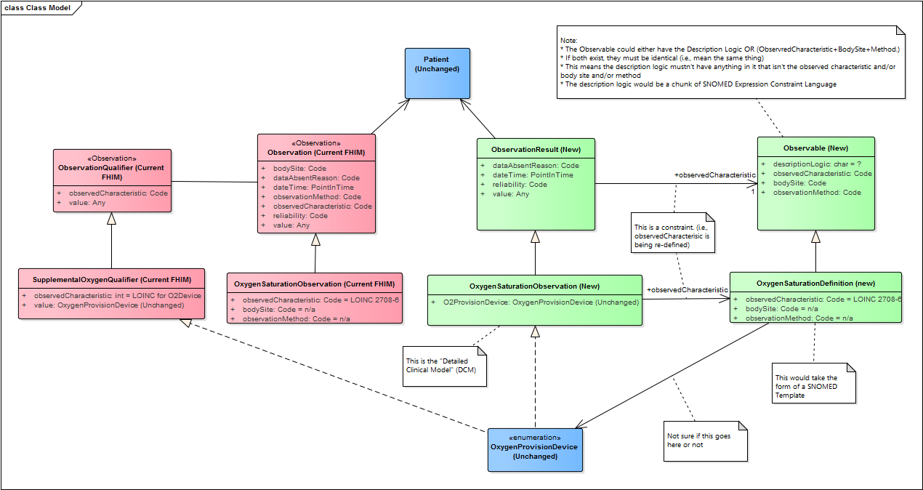

Slide 5
CDS and qm requirements
CDS and QM requirements can be boiled down to solving the “curly brace” problem.
The curly brace content should be Detailed Clinical Models – ideally CIMI DCMs.
DCMs are needed in different “modes” or “situational contexts (?)”
FHIM can provide the overarching logical model for how these modes are structured. CIMI provides the content
This requires introducing a new pattern to FHIM: Topic/Modality
This will result in another wholesale refactoring of the FHIM, but the refactoring for the Topic axis will be related to the Model of Meaning refactoring

Slide 6
Harmonize with cimi
The first area of harmonization to tackle is “Clinical Statement”
This is similar to the FHIM’s Clinical Information structure, which includes Provenance
Need to arrive at a harmonized Provenance structure. Will probably base on Intermountain’s CEM approach

Slide 7
Other things to tackle while we’re at it
Decide on a common approach to “negation”
Decide on a common position on Obsvervation vs Condition

Slide 8
status
After much effort on the part of many teams (which have several members in common), we are very close to achieving consensus
Next steps are to show updated models (FHIM), ADL (CIMI), and working code (CIMI, CDS, QM, FHIR) using the consolidated approach.

